Slide 1
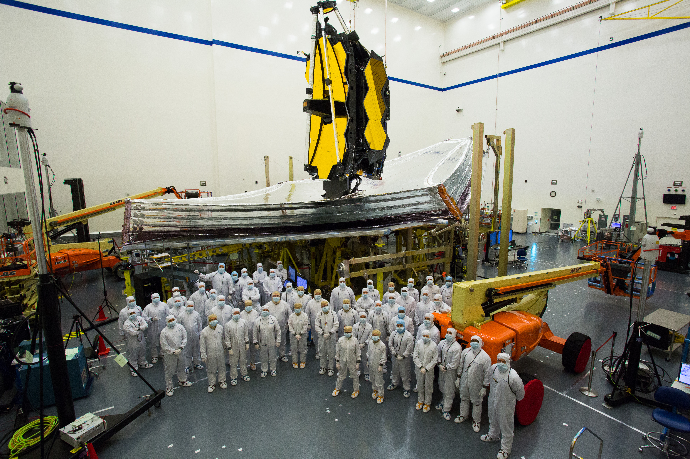
James Webb Space Telescope Town Hall
Eric P. Smith
JWST Program NASA HQ
235th American Astronomical Society Meeting 5-January-2020

Slide 2
2019 Recap
Significant Progress on three fronts
Spacecraft Element: Spacecraft Bus + Sunshield completed its environmental testing (launch vibration and acoustics, thermal vacuum)
Spacecraft Element and Science Payload (telescope & instruments) integrated to form the Webb observatory
Many Science & Operations Center commissioning rehearsals. Upgrades and enhancements to astronomer tools for Webb

Slide 3
WEBB OVERVIEW
An Introduction to the James Webb Space Telescope Mission video: https://www.youtube.com/watch?v=YF22Ba-xrk8

Slide 4
Remaining I&T Stages
Spacecraft Elem.
Post-environmental Deployments
Observatory
Pre-environmental Deployments
Observatory Environmental Tests
Observatory
Post-environmental Deployments
Observatory
Final Build

Slide 5
Remaining I&T Activities
SCE Post-
Environmental
Deployments
✓
✓
✓
✓
Deploy Tower
Deploy Sunshield Membranes
Sunshield Updates
Repair Sunshield Membranes
Fold Sunshield Membranes
Stow Tower
J2 Panel Opening
Stow Midbooms
Observatory Pre-environmental Deployments
Deploy Wings
Cryocooler field joint mate
Stow Wings
Full Stow UPS
Bipod Release 1st Motion
Deploy Tower
Partial Stow UPS
Install 4-bar/J3 Panel MRDs
Stow Tower
Full Stow UPS
OBS Closeout Operations
CST4/ GSEG 3
Launch Lock Tower Cable Tray
Observatory
Environmental
Test
Move OBS to LATF
Acoustic Test
Move OBS to M4
Vibration Testing
Move OBS to M8
GAA, CCA, STSA release
Deploy UPS
Deploy Tower
Deploy Sunshield Membranes
Stow Core
Fold Sunshield Membranes
CST5/GSEG 4
Observatory Post-environmental
Deployments
Stow Midbooms
Stow Tower
Deploy Wings
IEC, CJAA, ADIR +V3 Release
Stow Wings
Tower Deployment
Partial Stow UPS
Install 4-bar/J3 panel MRDs
Final Stow Tower
LL Tower Cable Tray
Full Stow UPS
✓
Observatory
Final Build
OBS Ready to ship to launch site
= Completed activities
Final OBS Ops
Shipping Preps
Blue boxes are first time activities

Slide 6
Simplified schedule
2020 |  |  |  |  |  |  |  |  |  |  |  | 2021
J | F | M | A | M | J | J | A | S | O | N | D | J | F | M
k
months of project funded critical path (mission pacing) schedule reserve
Launch Processing
1
TWTA, CTP Repair & System Test
Vibe & Acoustics Tests
Deployment & Stow
Final System Test
Shipping
Prep
1
Observatory
Ground System Freeze
Development, Testing, Release
Ground System
Cy1
Cy1
Cy1
TAC
Science
GO Proposal Call
GO Proposals Due
Northrop-Grumman
Space Telescope Science Institute
Guiana Space Center

Slide 7
Early Target Classes
133 Programs for ERS and GTO in Cycle 1
These programs occupy ~50% of the Cycle 1 time
General Observer (GO) time will be allocated through a proposal call to be released 23-January

Slide 8
Some Early “Famous” Targets
Deep Fields: GOODS North and South
Galaxies: Cen A, NGC 6240, Arp 220, Mrk 231, NGC 1068, NGC 4151, Andromeda dwarf galaxies
Stars: SN 1987a, Galactic Center stars, HH212
Exoplanets: WASP 79b, 43b, TRAPPIST 1b, e
Solar System: Jupiter, Saturn & Titan, Uranus, Neptune, Kuiper Belt Objects
National Aeronautics and Space Administration

Slide 9
Programmatics
Congress has funded Webb at the requested level for FY2020.
2019 Government Accountability Office (GAO) annual audit report noted significant progress and remaining schedule challenges, but contained no recommendations.
2020 Major Reviews: Observatory-level Pre-environmental, Cy1 TAC, Pre-ship, Operational Readiness

Slide 10
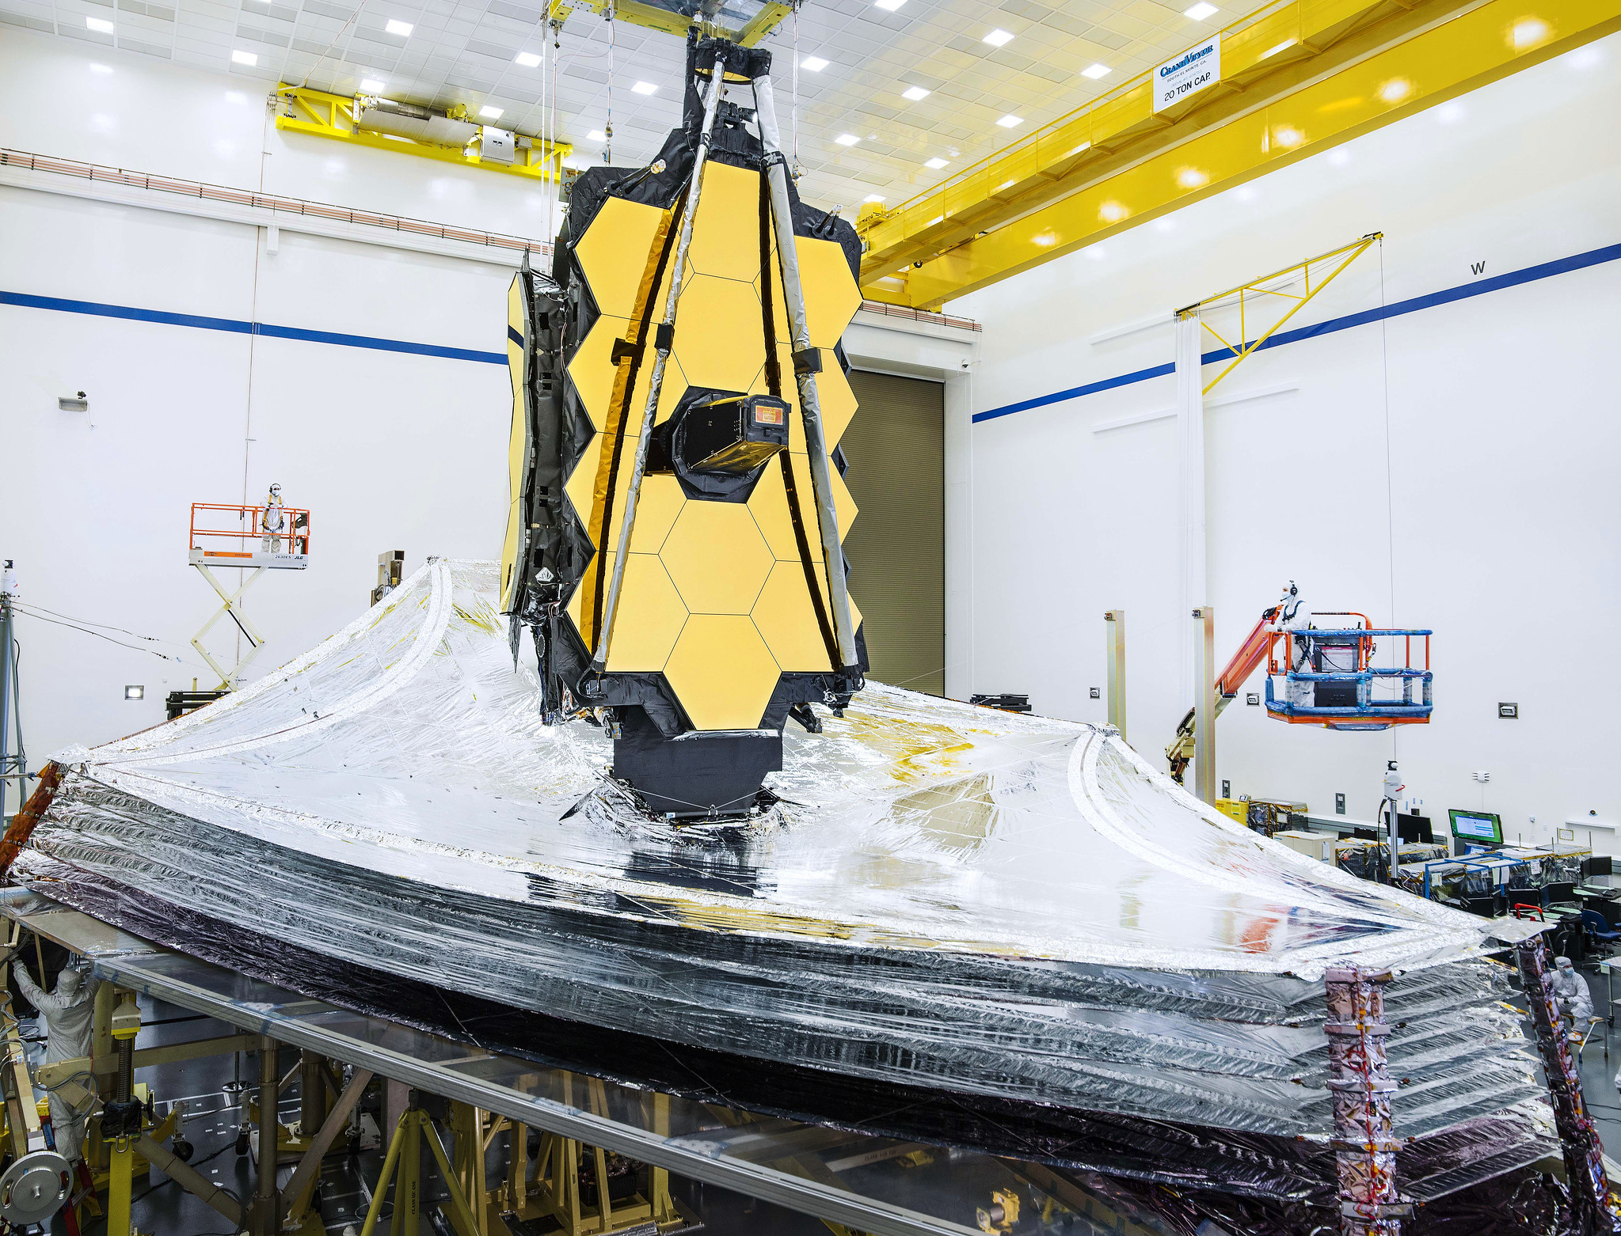
Summary
The fully integrated observatory will soon enter its ~year long test program prior to shipment
Webb performance predictions meet requirements with margin
General Observer Cycle 1 CfP release date: 23-January-2020
Though schedule margin is tight, JWST remains within budget and planning to a March 2021 launch readiness date

